Slide 1

INTELLIGENT TRAFFIC MONITORING SYSTEM
Final year Project
on
(2019-2020)
Submitted By :
Submitted to :
Sunil Kumar Maurya (1604310052)
Badal Tyagi (1704310903)
Bhanu Prakash Singh (1604310017)
Aman Chaudhary (1604310005)
DR R.N. VARMA
(Assistant Professor)
BUNDELKHAND INSTITUTE OF ENGINEERING AND TECHNOLOGY, JHANSI-284128

Slide 2




Project Team Details
Sunil Kumar Maurya
Bhanu Prakash Singh
Aman Chaudhry
Badal Tyagi

Slide 3
INTRODUCTION
Due to a huge number of vehicles ,very busy road and parking which may not be possible manually as a human being, tends to get fatigued due to monotonous nature of the job and they cannot keep track of the vehicles when there are multiple vehicles are passing in a very short time. So modern cities need to establish effective automatic systems for traffic management and scheduling.
The objective of this project is to design and develop an accurate and automatic number plate recognition system, Automatic traffic light control using google Api live traffic density data, smart fine system and also We can track the lost vehicle using vehicle number plate detection and find its location by google Map API.
Intelligent Traffic Monitoring System (ITMS) is an image processing and machine learning technology to identify vehicles by their license plates and we uses the microService of google API for live traffic density.

Slide 4
Project Objective
Increase the efficiency of existing transport infrastructure
Develop a license plate recognition system,
Build a smart fine system and in future enhancement automated fine systems for vehicles.
Live Traffic detection system and automated traffic light control system.
Predict the traffic density using machine learning for specific areas by its previous data.
Automated lost vehicle detection system and information to administration.
Handle traffic congestion using automated light control system.

Slide 5
Our project consists of six main modules :
License plate number recognition.
Matching the plate number with Database.
Intelligence traffic light control using live traffic density data.
Show traffic density of particular area for some duration of month in form of graph.
Online Vehicle license registration.
Smart fine system.
Selling your idea

Slide 6
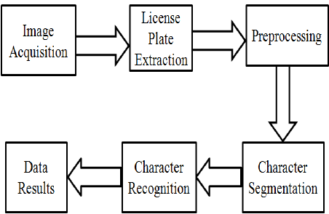
License plate number recognition.
License plate recognition systems is a image processing and machine learning algorithm and its main work is to extract the license plate from vehicle image and give the license number in alphanumeric form.
In license plate number recognition , there are 6 steps are involved:
Image acquisition
Convert image into grayscale Image
License plate extraction
Preprocessing image data
Character segmentation and Character recognition
Data result

Slide 7
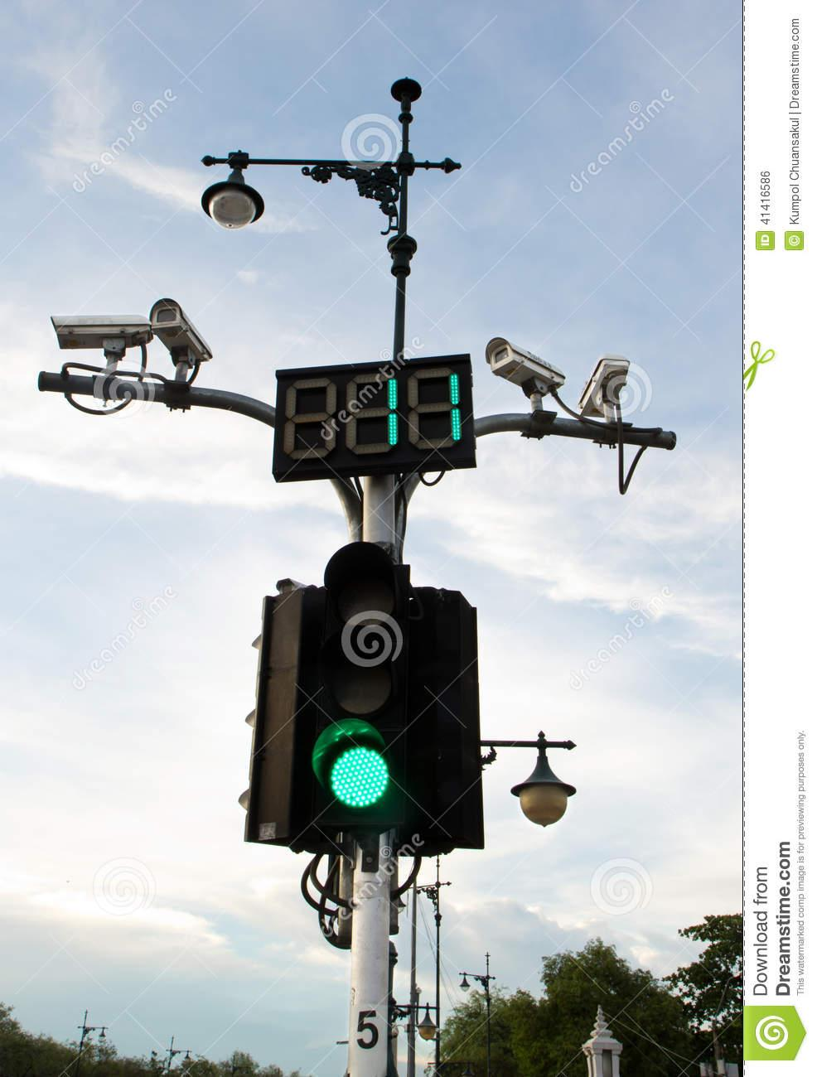
1.1 Image Acquisition
This is the first phase in an license plate recognition system. This phase deals with acquiring an image by an acquisition method. In our proposed system we used a high resolution digital camera to acquire the input image. The input image is 1200 x 1600 pixels.

Slide 8
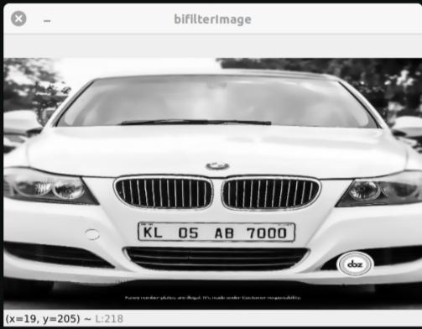
1.2 Convert image into grayscale Image
In License plate recognition system ,we do not required colored image and because coloured image is RGB form which is 3D space while grayscale image have only black and white 2D space the values ranges between 0–255 (8-bit unsigned integers) ,so it is easy to grayscale image and it solve complex operations in a shorter time.
So we convert the RGB image into grayScale image.

Slide 9
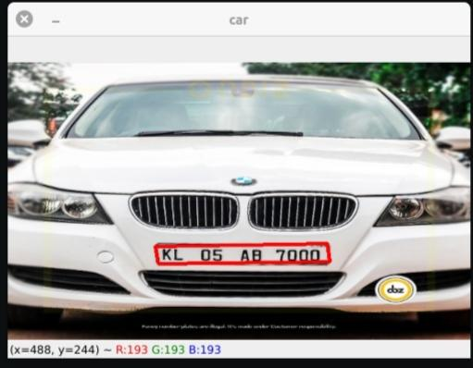
1.3 License plate extraction
License Plate Extraction is a key step in an ITMS system, which influences the accuracy of the system significantly. This phase extracts the region of interest, i.e., the license plate, from the acquired image. The proposed approach involves "Masking of a region with high probability of license plate and then scanning the whole masked region for license plate".

Slide 10
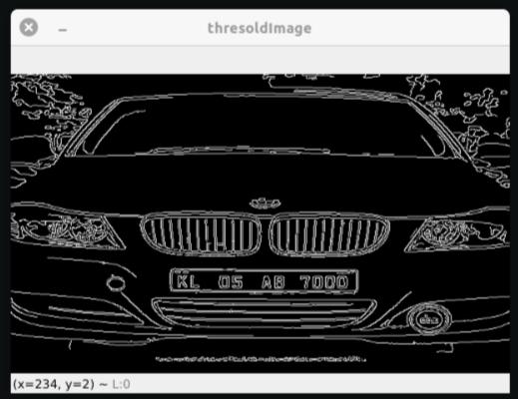
1.4 Preprocessing of image data
Pre-processing is a common operation in image processing and its aim is to improve image data and suppresses unwanted distortions and enhance some image feature.
In pre-processing of image we are generally do following things
pixel brightness transformations
geometric transformations
enhance image feature according to requirement.

Slide 11
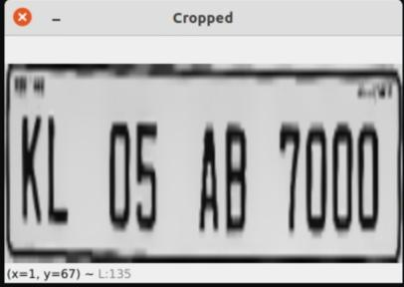
1.5 Character Segmentation and Character recognition
Character segmentation means recognise each character and separate them.
Character recognition is a machine learning process which recognise the character according it shape and divide it into category according to matching percentage with all A-Z and 0-9. We take the best matching percentage for each character.
This is our license plate number.
KL 05 AB 7000

Slide 12
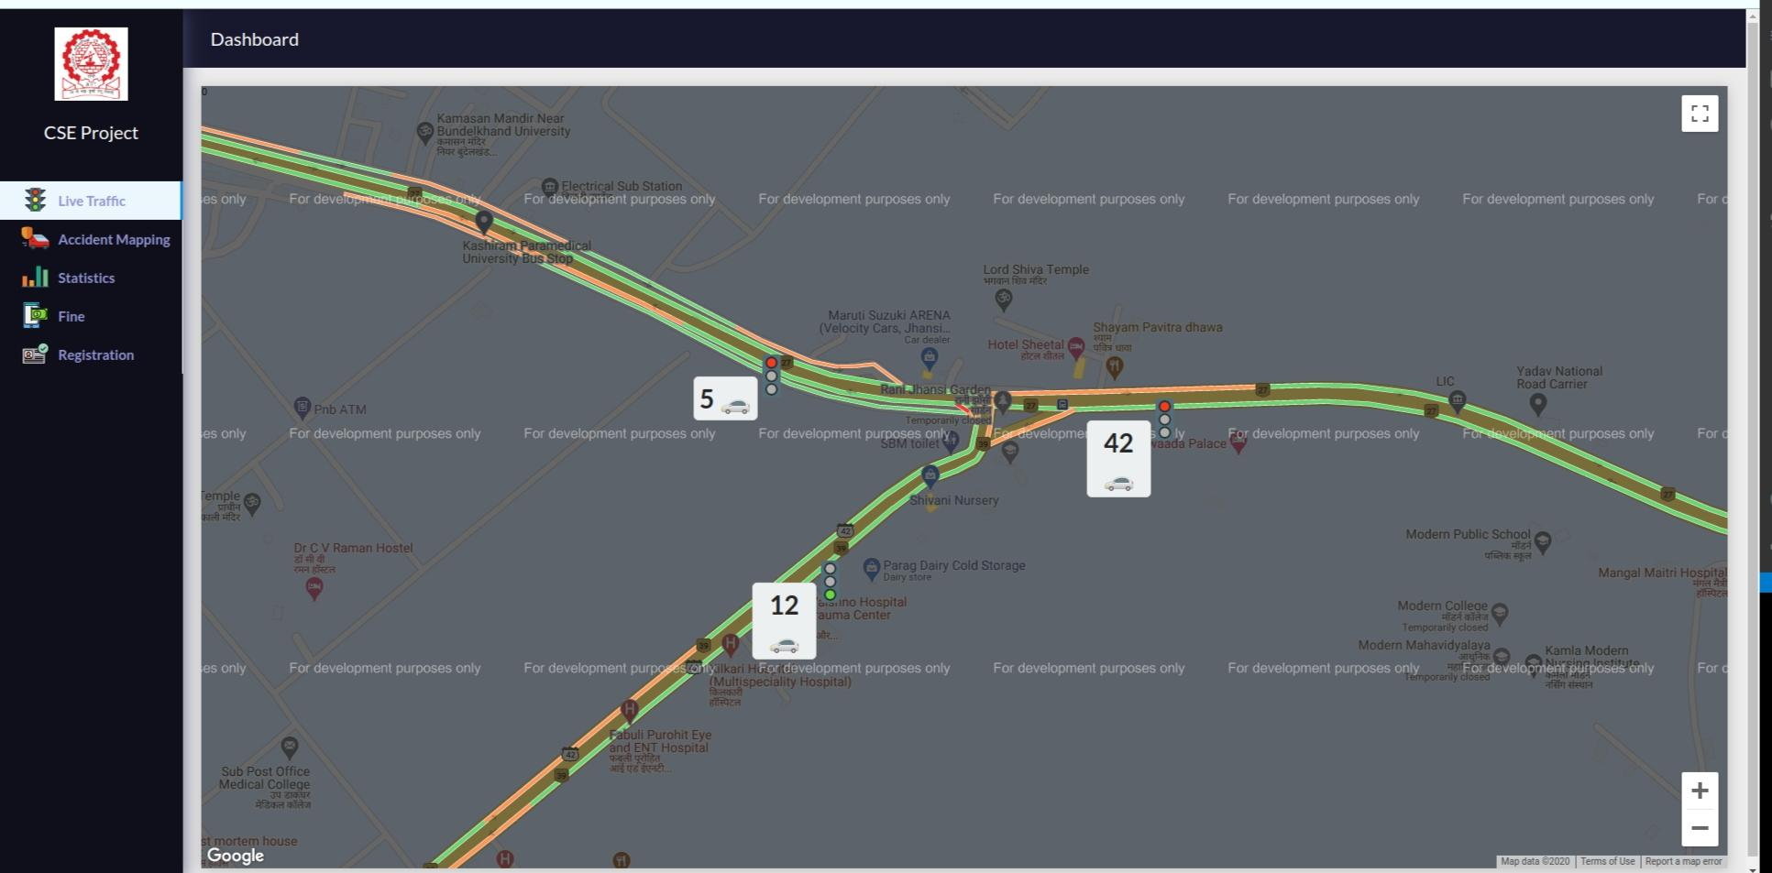
2 Intelligence traffic light control using live traffic data.
We are taking the live traffic density data from google map Api by giving the longitude and latitude position and google map api give the current location traffic data.
We can improve the live traffic data by using the cctv camera at traffic light.
After getting the number of vehicle at 3/4/ 5 ways crossing ,we can decide which side should be green signal according the traffic count and timestamp and this algorithm is like priority scheduling algorithm and we add timestamp for save from ageing condition.
So by using the above algorithm we can make the automatic traffic light control system.

Slide 13
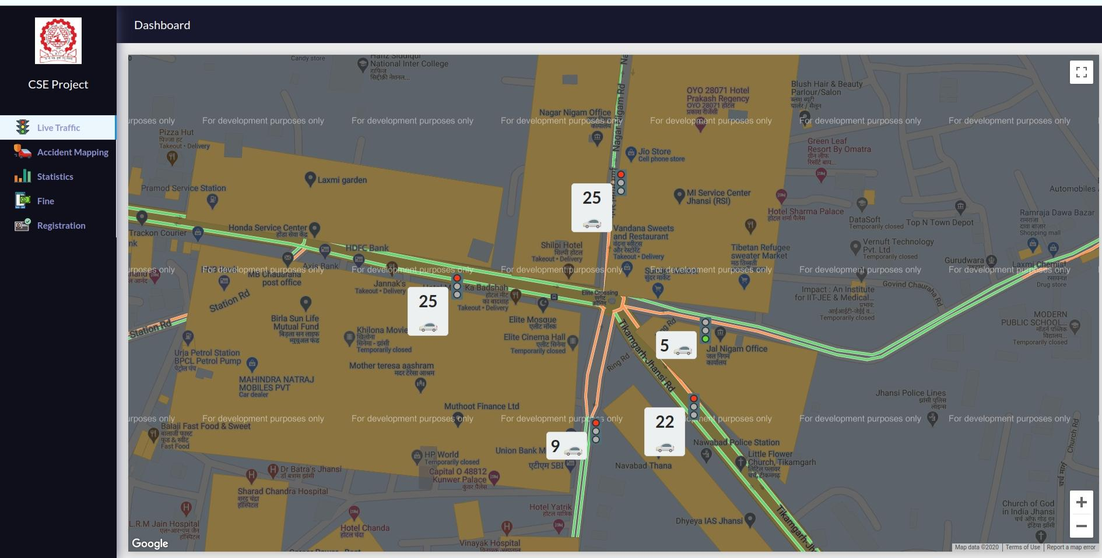
Automatic traffic light control

Slide 14
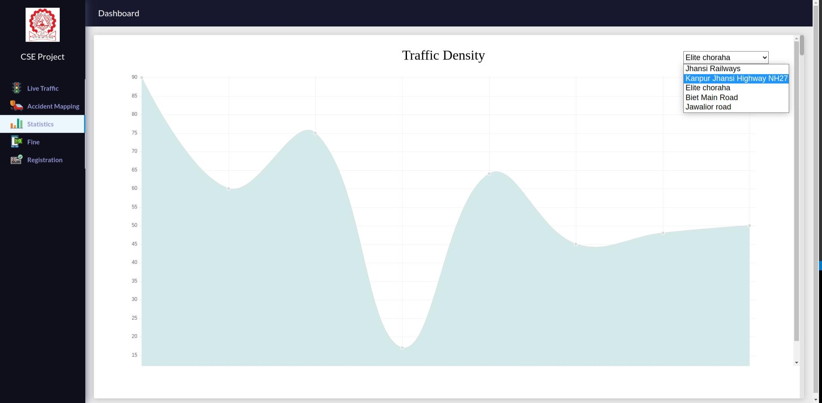
3 Traffic density of particular area in graph form.
In this we are showing the traffic density of some particular area in month wise and it will help us to predict the next day, month the traffic of those area.
Using the traffic density we can get the knowledge that in which time the traffic is higher. Using this data government would take the decision of road widening in some particular area to reduce the traffic congestion.

Slide 15
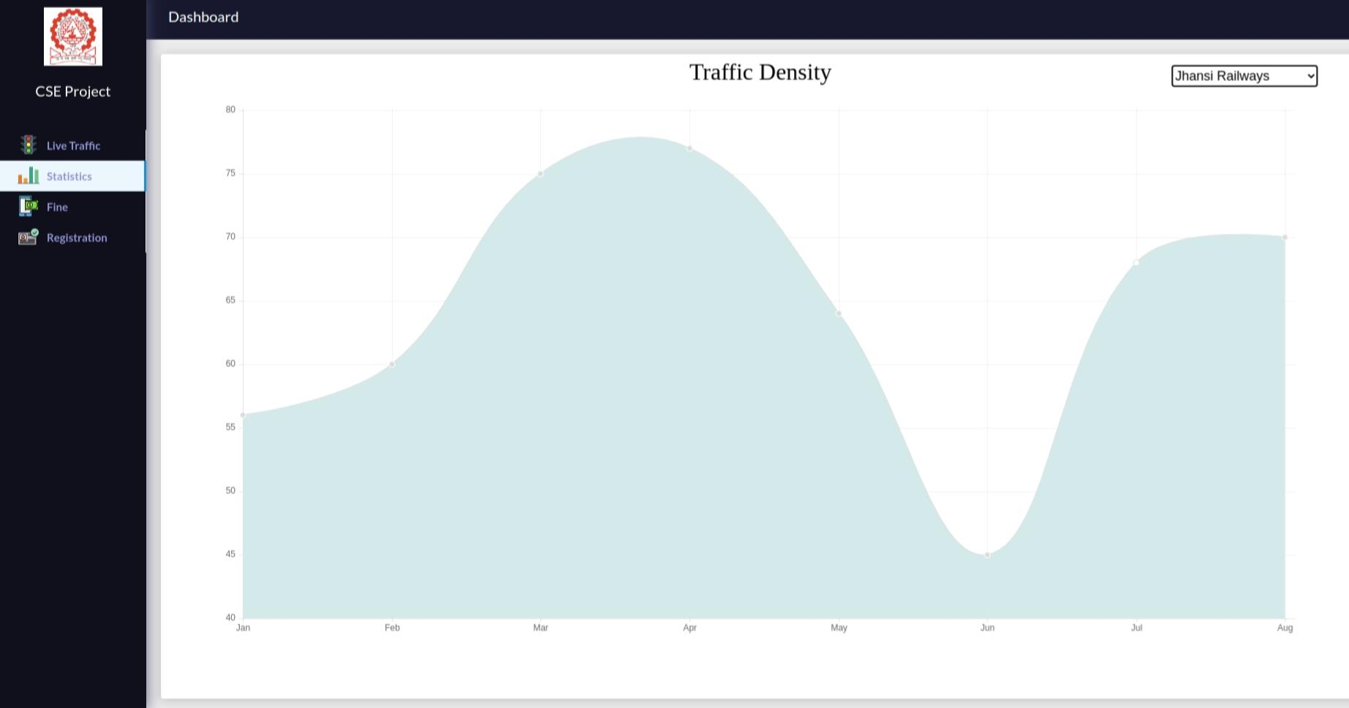
TRAFFIC DENSITY GRAPH

Slide 16
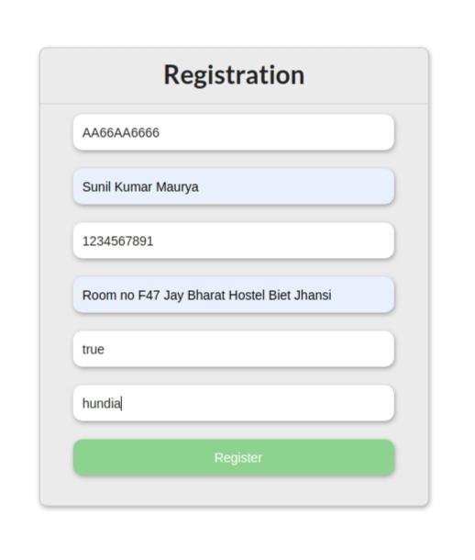
4 Online Vehicle license registration.
This is a registration form for new vehicle and in this form all field is mandatory ,mean use have to fill all the field.
It is only take the correct format of vehicle number and if user filled invalid vehicle number then it will not accept.
Correct format for indian vehicle number is
First two letter are Alphabet and next two are numeric and next two are alphabetic and next 4 are numeric.
Example: UP 65 AA 1234

Slide 17
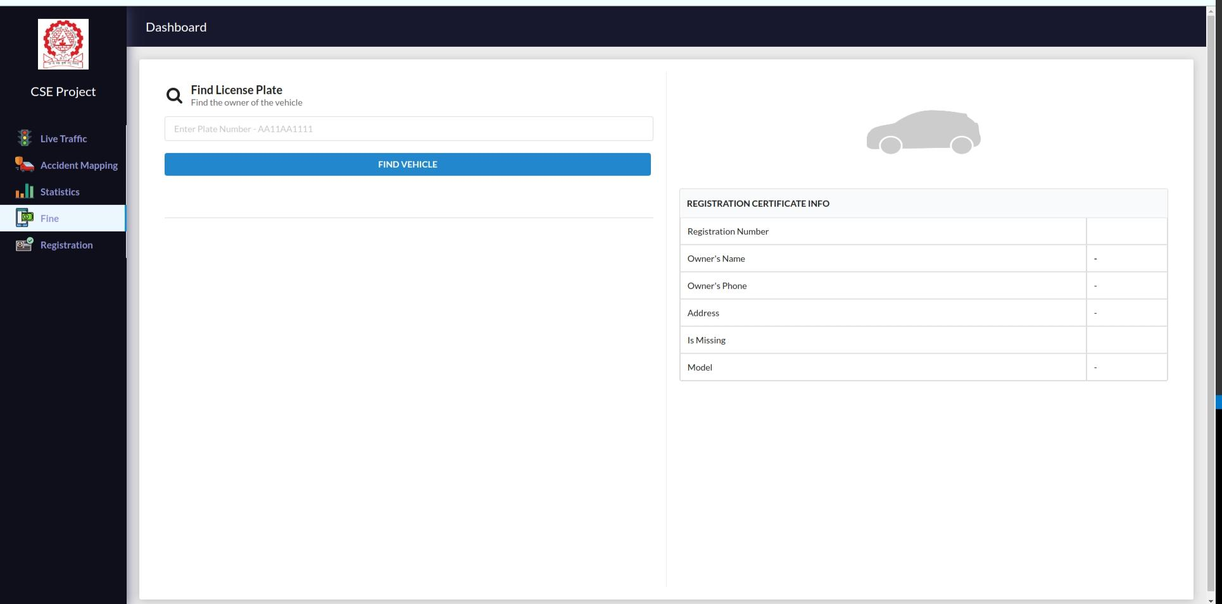
5 Smart fine system
This is a online fine system ,in which administration has to only fill the valid license number of vehicle and it will check vehicle number in our database and if data this vehicle is present in our database then it will show the detail of vehicle owner.
And then admin can send the fine to the user.

Slide 18
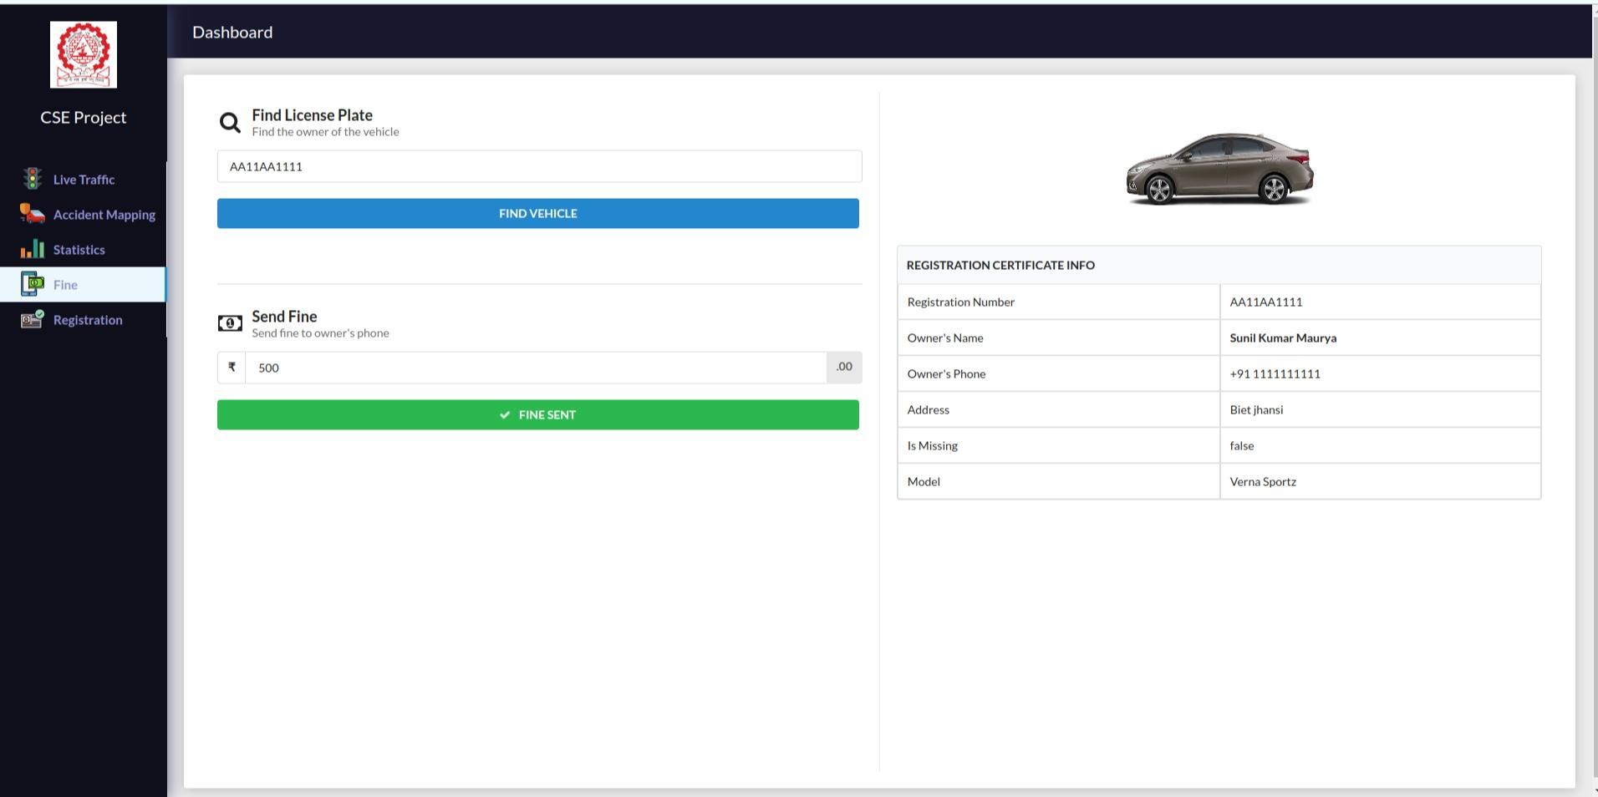
Smart fine system for breaking traffic rules.

Slide 19
Applications
Automated track the location of stolen vehicle
Anti-Theft/ Vehicle detection.
Traffic light automation ,no requirement of Traffic police.
Smart fine /E Challan Systems.
Car Parking / Automatic Toll Deduction.
Law Enforcement
VIP/Ambulance path Clearance
Help the government to take the decision of road widening and road construction according to traffic density data.

Slide 20
CONCLUSION
A simple effort has been made in this work to develop
an accurate and automatic number plate recognition system,
Automatic traffic light control using google Api live traffic density data,
smart fine system and also We can track the lost vehicle using vehicle number plate detection.
We have used Python for machine learning and optical character recognition with mongodb database to obtain the desired results.
License plate detection setup has been tested for 30 vehicles containing different number plates from different states. In the process of final evaluation after optimizing the parameters like brightness, contrast and gamma, adjustments, optimum values for lightening and the angle from which the image is to be taken. We get an overall efficiency of 98% for this system. Though this accuracy is not acceptable in general, still the system can be used for vehicle identification. It may be concluded that the project has been by and far successful. It can give us a relative advantage of data acquisition and online warning in case of stolen vehicles which is not possible by traditional manhandled check posts While thousands of vehicles pass in a day.

